Slide 1
Introduction to Contemporary Special Education: New Horizons
Second Edition
Chapter 3
Culturally and Linguistically Diverse Learners

Slide 2
Learning Objectives (1 of 2)
3.1–3 Describe the ways in which U.S. students are diverse, explain factors that contribute to an inequitable education for these students, and explain concerns regarding their disproportionate representation in special education.
3.4–6 Explain how cultural differences can create conflicts in school, list at least two steps that teachers can take to prevent cross-cultural dissonance, and describe culturally responsive instruction.

Slide 3
Learning Objectives (2 of 2)
3.7–8 Understand the process of second-language acquisition and describe effective programs and strategies for teaching English learners.

Slide 4
Diverse Learners
Describe the ways in which U.S. students are diverse, explain factors that contribute to an inequitable education for these students, and explain concerns regarding their disproportionate representation in special education.

Slide 5
3.1 The Diverse Landscape
U.S. schools have a long history of educating students from diverse cultural and linguistic backgrounds.
America’s schoolchildren are becoming increasingly diverse.

Slide 6
Who are diverse students, and how long have they been part of U.S. classrooms?
Many students come from racially, ethnically, culturally, or linguistically diverse backgrounds
Immigrants from diverse backgrounds have been part of U.S. classrooms since the founding of this country
Toward the end of the 1800s, immigrants experienced racism, segregation, and aggression
The civil rights movement brought national awareness to the inequities suffered by minority groups
Multicultural education emerged in the 1980s and encourages students to appreciate and respect others’ culture

Slide 7
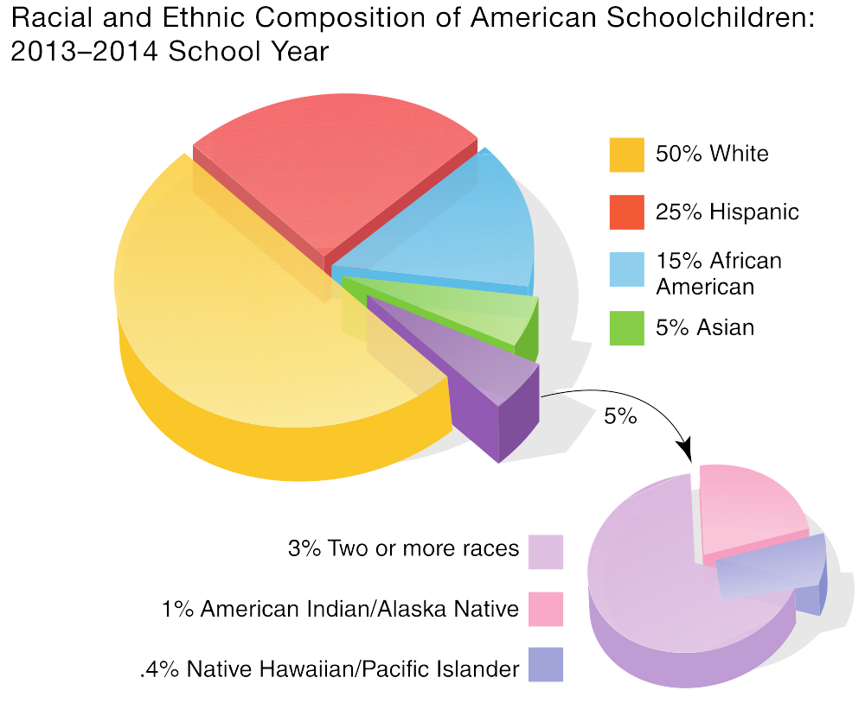
How diverse are students in U.S. schools?

Slide 8
3.2 Issues of Social Justice
Sociocultural disparities in key areas like parental education and income levels put students at risk for school failure.
Schools in low-income areas often provide an inequitable education for those students.

Slide 9
Do students from diverse backgrounds perform as well as those from the dominant culture?
Students from diverse backgrounds tend to have lower academic achievement and school performance
Students of color are 2-3 times more likely to live in poverty than their White peers which further increases the likelihood that these students will struggle academically

Slide 10
How do schools in low-income areas differ from those in middle- and upper-income areas?
Students of color often attend low-income schools
Tend to be larger, have higher student-teacher ratios, and have fewer resources
Have a harder time attracting and retaining highly qualified teachers
High rates of teacher turnover and student dropout
Discrimination and bias can cause educators to have low expectations for diverse students

Slide 11
3.3 Understanding Disproportionality
One concern about equitable education for students from diverse backgrounds relates to their disproportionate representation in special education.
Investigations of disproportionate representation in special education analyze identification and placement rates, as well as disciplinary actions.

Slide 12
Why is special education a concern for students from diverse backgrounds?
Racial, cultural, and linguistic differences can result in the misidentification of students as having a disability
Unnecessary placement in special education removes a student from the general education classroom, burdens the special education system, and exposes students to negative perceptions

Slide 13
What is disproportionality, and how is it determined?
School districts gather data on the racial and ethnic categories of students
Data is used to determine disproportionate representation, whether certain groups of students receive special education services at a higher or lower rate than expected
Disproportionate representation can be in overall special education enrollment, within specific disability categories, in placement decisions, or in disciplinary actions

Slide 14
Culturally and Linguistically Diverse Learners (1 of 2)
Explain how cultural differences can create conflicts in school, list at least two steps that teachers can take to prevent cross-cultural dissonance, and describe culturally responsive instruction.

Slide 15
3.4 Understanding Cross-Cultural Dissonance
Many of the behaviors we expect of children at school are based on cultural norms that students from other cultures or countries may not know.
As a result of these cultural differences, students may experience difficulties in school.

Slide 16
What is cultural diversity, and how can it influence the classroom environment?
Culturally diverse students are those with backgrounds that differ from the mainstream society
Diverse cultural backgrounds can cause students and teachers to misinterpret others’ words and actions

Slide 17
In what educational areas can cross-cultural conflicts occur?
Learning experiences and preferences
  Different cultures traditionally teach in different ways
Behavioral expectations
  Different cultures have different behavioral norms
Communication styles
  Differences in communication can lead to misinterpretations
Curricular representation
  Lessons and materials should reflect diversity

Slide 18
3.5 Preventing Cross-Cultural Dissonance
Teachers who engage in critical self-reflection can anticipate where cross-cultural dissonance may occur.
Teachers who understand their students’ cultures may prevent culturally based problems from arising.

Slide 19
How can teachers anticipate where cross-cultural dissonance might occur?
Recognize that differences and lack of knowledge can make people uncomfortable and cause misunderstandings
Understand the role that cultural diversity plays in the learning process
Engage in reflective self-examination of attitudes and assumptions and the impact those beliefs have in the classroom
Engage in reflective examination of students’ attitudes and assumptions

Slide 20
What should teachers do to address areas of possible cross-cultural dissonance?
Inform students about any mainstream cultural knowledge they may be missing
Learn about students’ families, backgrounds, and beliefs
Do not stereotype groups of individuals or assume that all people from the same culture hold similar beliefs and traditions

Slide 21
3.6 Providing Culturally Responsive Instruction
Teachers must be culturally competent, which includes being knowledgeable about students and their home cultures.
Culturally responsive instruction teaches to the strengths of each student while validating and affirming his or her culture.

Slide 22
What is a culturally competent teacher?
Acknowledges students’ differences and recognizes that these differences may impact learning
Learns about the families, backgrounds, and cultures of diverse students
Uses student culture as a basis for learning
Enriches instruction with examples and perspectives from many cultures
Reflects on the impact of own culture on instruction

Slide 23
How does culturally responsive instruction help students succeed in school?
Acknowledges and legitimizes different cultural heritages in the classroom
Incorporates a wide variety of instructional techniques to meet varied learning needs
Incorporates multicultural knowledge, resources, and materials in all subjects
Increases understanding and appreciation of cultural differences among all students
Explicitly teach classroom expectations, especially when those expectations may differ from those at home

Slide 24
Culturally and Linguistically Diverse Learners (2 of 2)
Understand the process of second-language acquisition and describe effective programs and strategies for teaching English learners.

Slide 25
3.7 Understanding Second-Language Acquisition
Many terms are used to refer to students who speak a language other than English as their first language.
Proficiency in a second language develops in stages; academic language proficiency is complex and takes significantly longer to develop than social language.

Slide 26
What is linguistic diversity?
In the U.S., linguistically diverse refers to students whose home or native language is not English
  English language learners (ELLs)
  English learners (ELs)
  Language minority students
Dual language learners are students who are learning more than one language simultaneously

Slide 27
How does second-language acquisition occur, and how long does it take? (1 of 2)
Second language acquisition goes through stages
  Stage 1: Silent/receptive language
  Stage 2: Early production
  Stage 3: Speech emergence
  Stage 4: Intermediate language proficiency
  Stage 5: Advanced language proficiency

Slide 28
How does second-language acquisition occur, and how long does it take? (2 of 2)
Receptive language develops sooner than expressive language
Basic conversational skills can be acquired in 2-3 years
Academic language skills can take 5-7 years to develop proficiency

Slide 29
3.8 Effective Practices for ELs
Many program options exist to help ELs improve their English skills; the most effective are bilingual programs.
General education teachers can use strategies to help linguistically diverse students learn academic content while developing their English skills.

Slide 30
What types of services are available to support linguistically diverse students?
(1 of 2)
Two-way or dual language immersion
  All students learn academic content and a second language with the goal of bilingualism and academic proficiency
  Most effective program
Developmental bilingual education
  ELs learn academic content in both native language and English
  Most students need 4-7 years for academic proficiency in English

Slide 31
What types of services are available to support linguistically diverse students?
(2 of 2)
Transitional bilingual education
  First language academic instruction & separate English instruction
  Students are often pulled out of the classroom for instruction
English as a second language (ESL)
  Students are pulled out of the classroom for instruction in English only
  Most frequently implemented but least effective program

Slide 32
What can general education teachers do to support ELs’ success in class?
Sheltered instruction
  Hands-on activities and manipulatives
  Speak slowly and clearly, explaining unfamiliar vocab
  Demonstrations
  Multimodal means of presenting information
  Develop language objectives to support content objectives

